Slide 1
The new ¥ _______ banknote

Slide 2
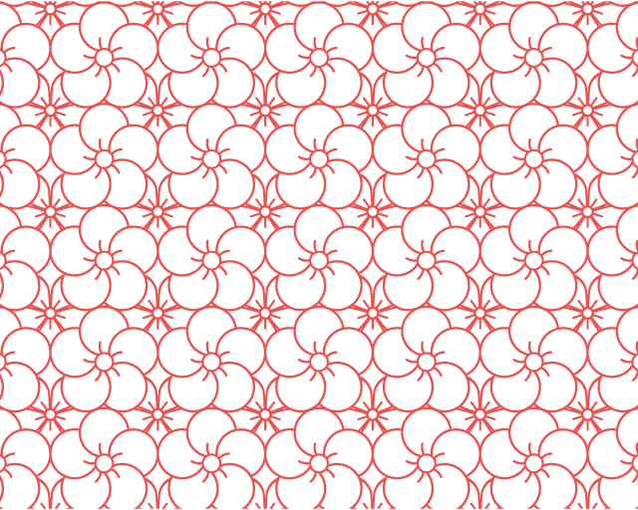
Design Elements 1

Slide 3
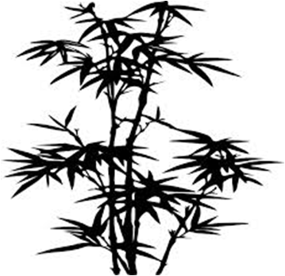
Design Elements 2

