Slide 1
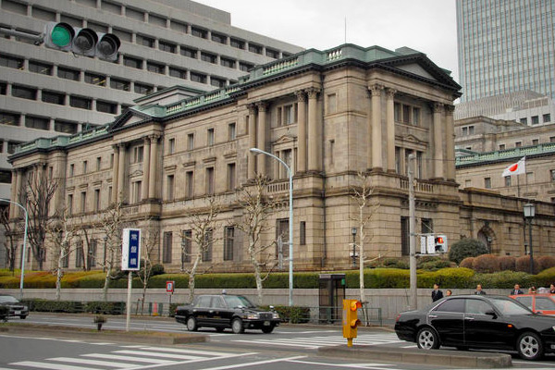
New Y1000 Note Designs
1
2
3
4
5
6
7
Notes:
The Numbers hyperlink to the relevant slides.
The Back Button goes back to Slide 1 – You can just make 1 then copy and paste it. The function is also pasted.
You must use Slide Show > Set Up Show > Browsed at Kiosk otherwise the students can click anywhere and cause chaos.

Slide 2
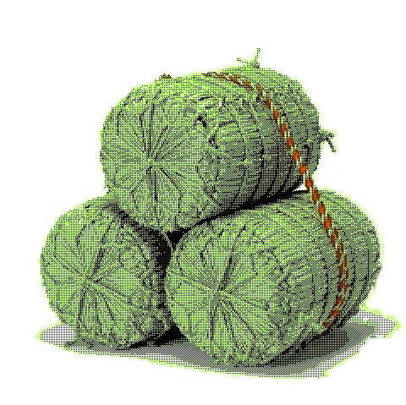
1
10,000
10,000
10,000
10,000
10,0
10,000
000
10,000
10,000yen
10,000
10,00
10,000
10,000
10,000

Slide 3
2
10000
10000

Slide 4
3
4000
4000
四千円
Anton 銀行
ANTON GINKO
4000
YEN
4000

