Slide 1
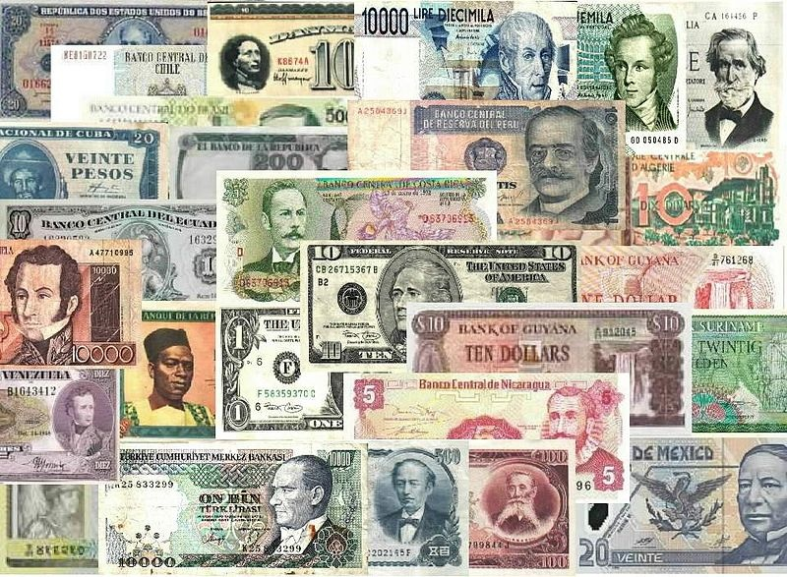
banknotes of the World

Slide 2
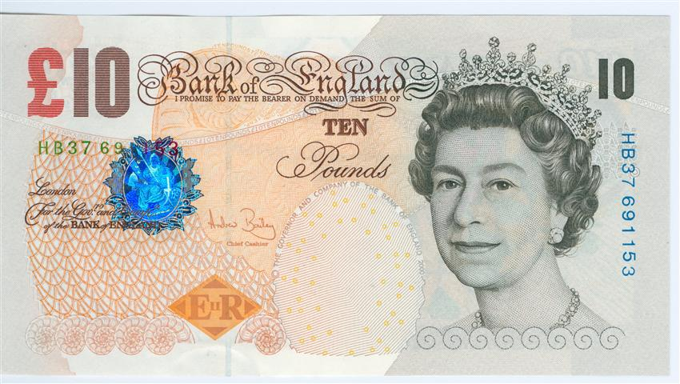
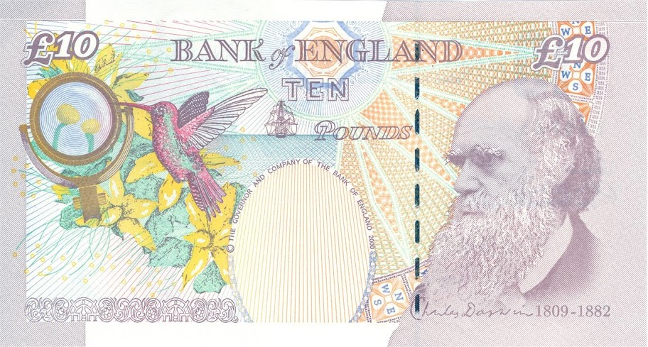
The British 10 Pound note
Queen Elizabeth II
Charles Darwin
HMS Beagle
Galapagos
Notes:
Queen = calm and serene = Order = Historical social order and calm
Darwin = Deep in thought = intellectual scientific life
Beagle = Ruler of the seas = exploration = discovery of the exotic (bird / flowers) = Brit exploration benefits everyone

Slide 3
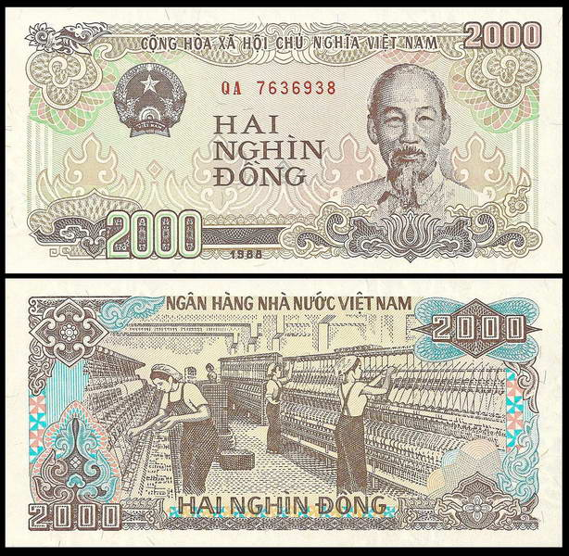
The Vietnamese 2000 Dong note
Ho Chi Minh
Cotton Factory
Communist
Notes:
“Uncle Ho” = friendly face, knowing grin.
Cotton factory = Cotton a key industry = workers (communist priorities)
Workers = everyone busy, same clothes, no boss, everyone same height = social equality

Slide 4
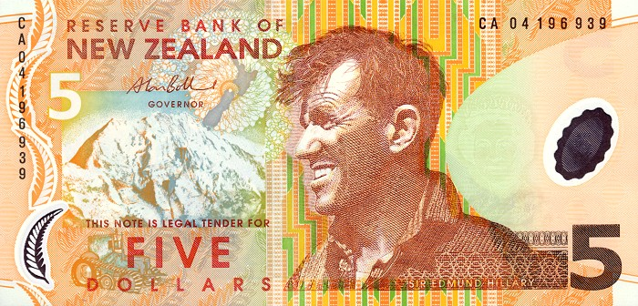
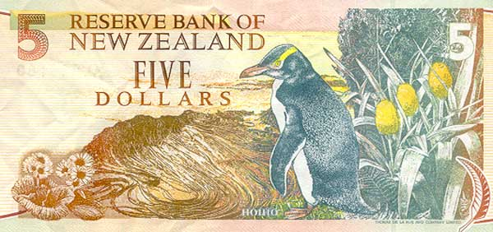
The New Zealand 5 Dollar note
Edmund Hilary
Yellow Eyed Penguin
Notes:
Hilary – Bigger than Mount Cook, rugged, tough but good fun. He looks real. Looks like he respects/loves Mt Cook more than Everest. Hilary = conquering nature.
Yellow eyed penguin – native to NZ. Their colonies are a popular tourist location. Considered the oldest type of penguin. Big conservation campaign is ongoing.

Slide 5
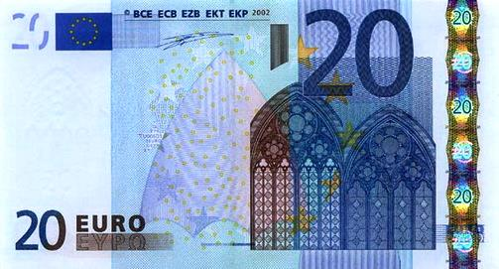
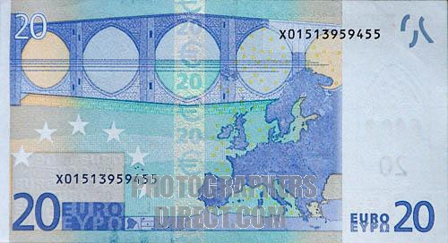
The 20 Euro note
Arches
Bridge
Notes:
Euros were designed to be as neutral as possible – no famous people, places etc just images of things that don’t exist so that one nation doesn’t feel more important than another. Shows the paranoia of european disintegration (WW1, WW2 etc)
Gothic Arches = pan european style = represent support
Bridges = linking
Map is interesting as it includes UK which doesn’t use the Euro = keeping the door open? Interestingly the UK wanted a special deal whereby they could make their own Euros. The bureaucrats in Brussels had a fit!

Slide 6
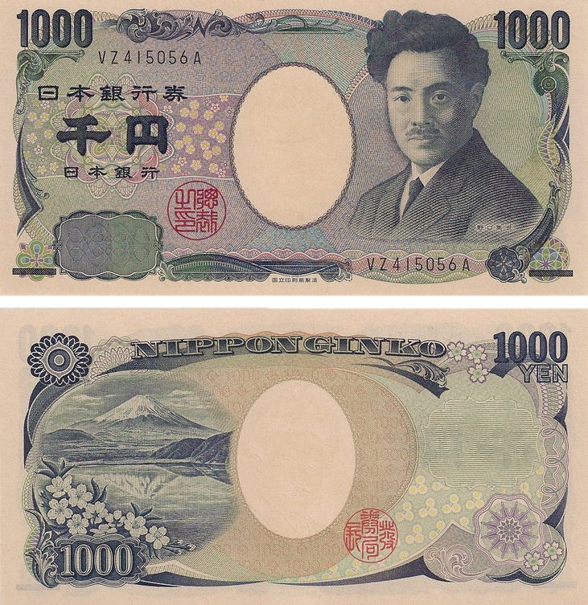
The 1000 Yen note
Hideyo Noguchi
Yellow Fever
Syphilis
Fuji
Notes:
Noguchi is a classic – In Japan he is remembered fondly as a pioneer in the creation of a vaccine for Yellow Fever.(endemic to Africa and South America, not Japan) = Science, Japan’s internationalism and benevolence to the world outside Japan. Also from a poor family and lost the use of a hand as a baby. = Triumph over adversary = gambaru spirit.
Actually he was a bit of a nutter. He died of yellow fever and got a number of his co workers infected too. His major research was with syphilis! during which he dabbled in human experimentation with invalids. Nice one. He also accidently infected himself with syphilis and never had it treated which reportedly made him insane.
Fuji – everlasting symbol of Japan in so many ways. All the flowers give the impression of “washi” – Japanese hand made paper

