Slide 1
The Currency of North Korea
By Sharaku Seiya

Slide 2
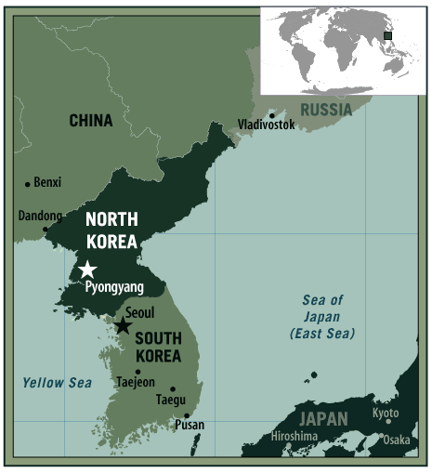
North Korea
North Korea is in Asia
It is a communist dictatorship, run by Kim Jon Un
It is very poor and simple
It has a population of 24,000,000
It has an extended military of about 9,500,000

Slide 3
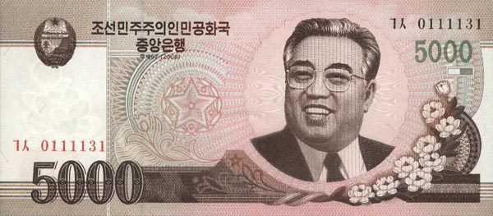
5000 Won note
Kim Il Sung
Mangyongdae
Notes:
Slide 3 – The highest denomination note shows the highest regarded official. Kim Il Sung is almost like a sun shining through the clouds in the background. Mangyondae looks pristine and is surrounded by nature. This begins two themes – the quasi religious glorification of the leaders birthplace (similar to Bethlehem / Mecca / Lumbini (Buddha)) and the association between the leaders and the nature of NK.

Slide 4
2000 Won note
Log cabin
Baekdu Mountain
Notes:
Slide 4 - The 2nd highest note goes to Kim Jong Il. Surprisingly he doesn’t appear on the note. Maybe he will in the future. What we do have though is the Log cabin where Kim Jong Il is supposed to have been born. The log cabin symbolizes his simple, frugal “man of the people” beginnings while again associating the KIM family with nature. The Cabin almost acts as fertilizer to lush flora surrounding it. The cabin is located on Baekdu mountain which has numerous. Koreans consider Mount Baekdu as the place of their ancestral origin and as a sacred mountain. It is also the highest mountain on the Korean peninsula

Slide 5
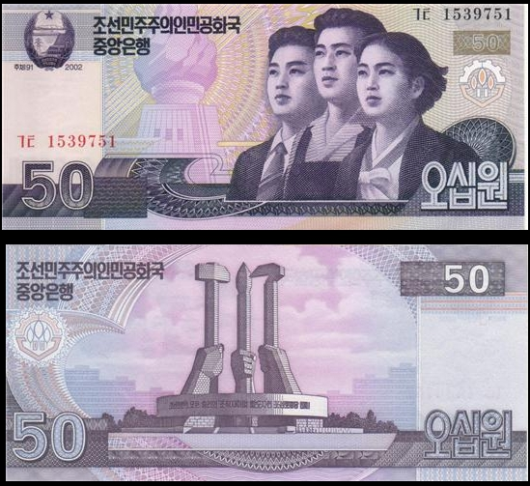
50 Won note
Engineer, Farmer and Intellectual
Monument to the Founding of the Workers' Party of Korea
Notes:
Slide 5 – Lower denominations feature lower level members of society. The 3 workers represent 3 important cultural/ industrial aspects of North Korean life. They are all well fed, well clothed and almost identical (unity of the people) They are looking towards the Juche Tower, a monument in Pyongyang which celebrates the country’s self reliance.
On the reverse is a well known monument called the Workers Party Monument which celebrates the workers but more importantly the communist party of NK. Note the lack of nature.

Slide 6
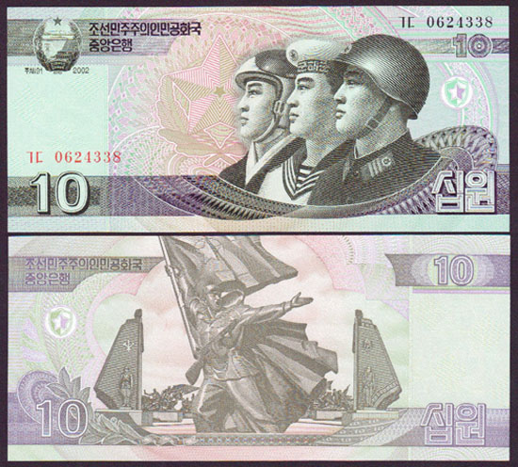
10 Won note
Military personnel
Victory Monument of the Korean War
Notes:
Slide 6 – The military get a nod here. Again 3 figures with the Army at the front as it is the most important of the 3 services. Very similar faces indicate their unity. They are looking proudly at a star which represents the communist party. A kind of defensive, comforting ring seems to be extending from the start around the shoulder of the soldier in the front. This might be trying to hint at the mutual support between the party and the military. (In reality the Military get first dibs on food and gasoline).
On the reverse is yet another Pyongyang monument called Victory Monument of the Korean War, which is odd as they didn’t win.

